Slide 1

Design Pattern – Factory Patterns

Slide 2
What is Design Pattern
Addresses a recurring design problem that arises in specific design situations and presents a solution to it.
Constitutes a set of rules describing how to accomplish certain tasks in software development
Focus more on reuse of recurring architectural design themes, while frameworks focus on detailed design and implementation
Identify and specify abstractions that are above the level of single classes and instances or of components. (Gamma, Johnson, and Vlissides, 1993)
Helps in improving code quality

Slide 3
Little bit of History
Began to be recognized more formally in the early ‘90s by Eric Gamma - described patterns incorporated in the GUI app f/w
Continued Discussion & meeting lead to publication of parent book – “Design Patterns: Elements of Reusable Software” by Gof (Erich Gamma, Richard Helm, Ralph Johnson, & John Vlissides) in ‘95
  Had a powerful impact on S/W Development community
  Became an all-time bestseller. Describes 23 commonly occurring & generally useful patterns & comments on how and when to apply them.
Other useful books were published later
  One closely related book is The Design Patterns Smalltalk Companion
  Later books on different language like Java, VB, .net were published

Slide 4
Grouping Design Patterns
Creational patterns create objects for you rather than having you instantiate objects directly. Gives program more flexibility in deciding which objects need to be created for a given case
Structural patterns help you compose groups of objects into larger structures, such as complex user interfaces or accounting data.
Behavioral patterns help you define the communication between objects in your system and how the flow is controlled in a complex program.

Slide 5
Grouping Design Patterns – Examples
Creational | Structural | Behavioral
Abstract Factory | Adapter | Iterator
Factory Method | Façade | Observer
Builder | Proxy | Chain Of responsibilities
Singleton | Composite | Command
Prototype | Bridge | Template Method

Slide 6
Factory Design Patterns
Just what their name implies: they are classes that create or construct something.
Provide encapsulation of code required to render an instance of abstract class type as an implementation class
Provides a simple decision-making class that returns one of several possible subclasses of an abstract base class, depending on the data that are provided.
The factory can initialize, pull in data, configure, set state, & perform nearly any other creational operation needed
Three different flavors of Factory Design Patterns -
  Simple Factory
  Abstract Factory
  Factory Method

Slide 7
Simple Factory
Very popular – could be found again & again
Returns an instance of one of several possible classes, depending on the data provided to it.
Usually all of the classes it returns have a common parent class and common methods but each of them performs a task differently and is optimized for different kinds of data.
Not a GoF patterns, but it serves here as an introduction to the somewhat more subtle Abstract Factory & Factory Method GoF pattern

Slide 8
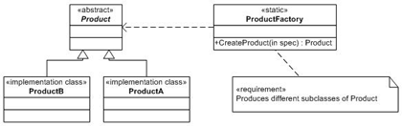
Simple Factory Class Diagram
Two main parts –
  Factory Class
  Product Class
Factory class renders the Product class
Product class contains data or functionality & is part of a series of class types that can be rendered from Factory class

Slide 9
Problem 1
Implementation classes with a common base are created in multiple places
No uniformity exists between creational logic
.....lives in class FindSuit
Suit suit;
if(suitType == SuitType.Armani)
suit = new Armani();
else if(suitType == SuitType.StripedBusinessSuit)
suit = new StripedBusinessSuit();
.....lives in class GetSuit
if(suitType == SuitType.PlaidBusinessSuit)
suit = new PlaidBusinessSuit();
else if(suitType == SuitType.GolfSuit)
suit = new GolfSuit();

Slide 10
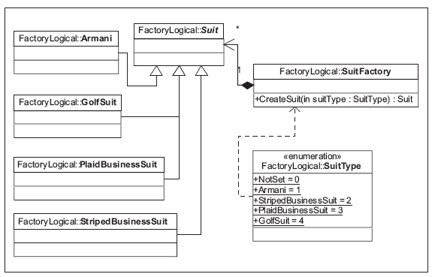
Solution 1
Encapsulate the creation and decisional process of which type of the Suit class to create
Central place to house the conditional code.

Slide 11
Solution 1 – Code Example
public sealed class SuitFactory
{
public Suit CreateSuit(SuitType suitType)
{Suit suit;
if(suitType == SuitType.Armani)
suit = new Armani();
else if(suitType == SuitType.StripedBusinessSuit)
suit = new StripedBusinessSuit();
else if(suitType == SuitType.PlaidBusinessSuit)
suit = new PlaidBusinessSuit();
else if(suitType == SuitType.GolfSuit)
suit = new GolfSuit();
return suit;
} }
.....refactored in class FindSuit & GetSuit
SuitFactory factory = new SuitFactory();
Suit suit = factory.CreateSuit(SuitType.Armani);

Slide 12
Abstract Factory
Expands the basic Factory pattern
Gives us a way to allow factories with similar methods and access points to be interchangeable.

Slide 13
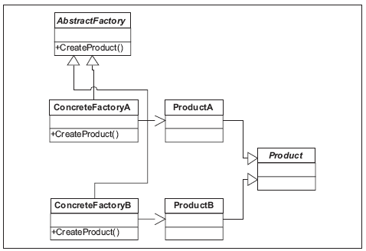
Abstract Factory Class Diagram
Two main components:
  Abstract Factory
  Abstract Product.
Expands the basic Factory pattern
Gives us a way to allow factories with similar methods and access points to be interchangeable.

Slide 14
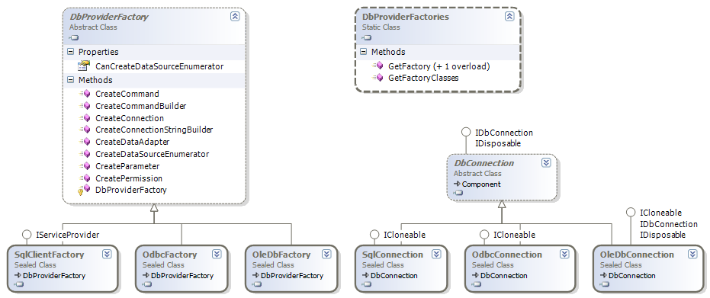
Abstract Factory usage in .net BCL/FCL
DbProviderFactory factory = DbProviderFactories.GetFactory("System.Data.SqlClient");
DbConnection conn = factory.CreateConnection();
MessageBox.Show(conn.GetType().ToString());

Slide 15
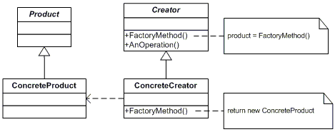
Factory Method Class Diagram

Slide 16
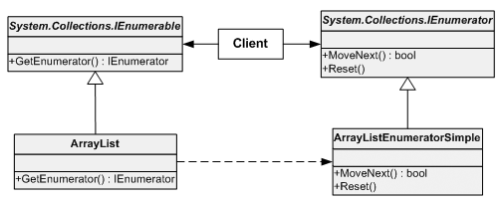
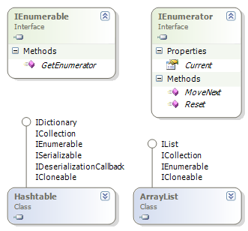
Factory Method used in .net FCL
ArrayList al = new ArrayList();
al.Add("asd");
MessageBox.Show(al.GetEnumerator()
.GetType().ToString());
Output -
Hashtable ht = new Hashtable();
ht.Add("key1","asd");
MessageBox.Show(ht.GetEnumerator()
.GetType().ToString());
Output -

Slide 17
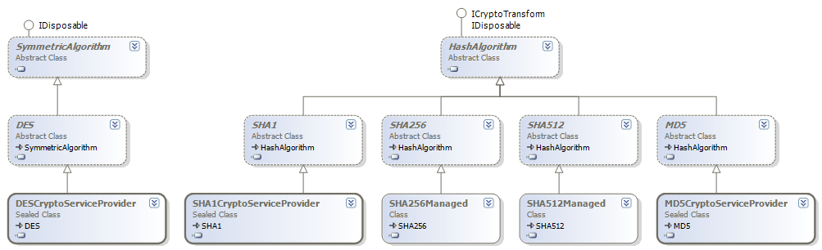
Parameterized Factory Method used in .net FCL
SymmetricAlgorithm symAlgo = SymmetricAlgorithm.Create(“MD5");
MessageBox.Show(symAlgo.GetType().ToString());
Output -
SymmetricAlgorithm symAlgo = SymmetricAlgorithm.Create(“SHA1");
MessageBox.Show(symAlgo.GetType().ToString());
Output -

Slide 18
Resources
Website
  Usage of factory Method with in .net FCL/BCL- http://www.ondotnet.com/pub/a/dotnet/2003/08/11/factorypattern.html
  Design Patterns in C# and VB - http://www.dofactory.com/Patterns/Patterns.aspx
Books
  Design Patterns – GOF
  Design Patterns – Christpher G Lasater
  Software Factories – Jack Greenfield and Keith Short

Slide 19
Questions
If (Questions == null || Questions.Count == 0)
{
Thank you;
}

